Slide 1
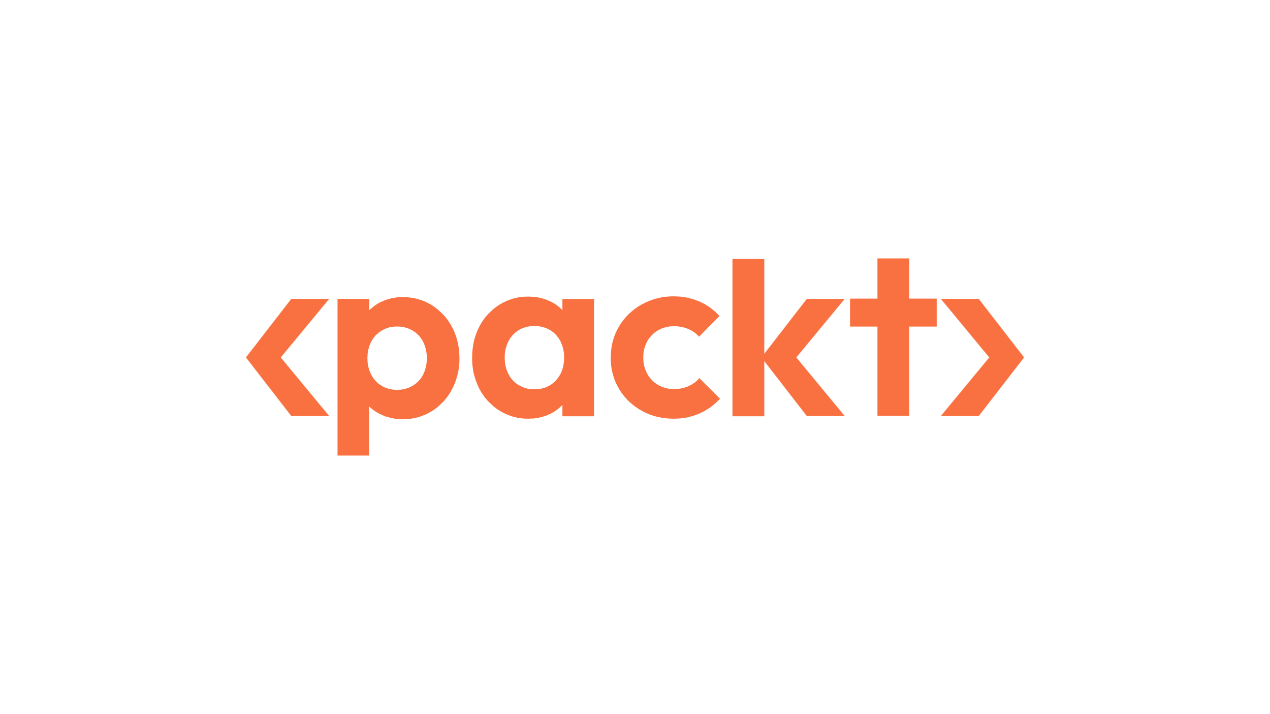

Feel free to leave speaker notes or inline comments on any slide—our design team will review them and help enhance your deck wherever needed.
Feel free to leave speaker notes or inline comments on any slide—our design team will review them and help enhance your deck wherever needed.
Feel free to leave speaker notes or inline comments on any slide—our design team will review them and help enhance your deck wherever needed.
GUIDELINES
How to Use This Deck for Your Session
Welcome to the Packt ML Summit 2025! This template is designed to help you deliver a high-impact, well-paced session. Feel free to duplicate, remove, or reorder slides based on your talk format.
REQUIRED SLIDES
STARTING NOW: This will go on the waiting screen for ~30-60 seconds before you go LIVE.
Session TITLE
About The Speaker
Agenda
Content Slides
Thank You
OPTIONAL SLIDES
Code snippets / architecture diagrams
Case Studies or example walkthroughs
Session TITLE
Audience Poll: We can automate the poll via the platform and obtain real time results as users take the poll. Good prop to engage.
Resources
FORMAT SPECIFIC
Power Talk (30 min): Focus on content + clear takeaways
Tech Talk (45 min): Deep dive with walkthroughs and demo
Workshop: Include setup instructions, step-by-step structure
Feel Free to leave speaker notes or comments on any slide – our design team will review and help enhance your deck wherever needed.

Slide 2

Starting Now
Zero-Shot Time Series Forecasting with TimeGPT
Zero-Shot Time Series Forecasting
Holiday, special dates, and historical variables
Khuyen Tran
Founder of CodeCut DevRel @ Nixtla

Slide 3

Zero-Shot Time Series Forecasting with TimeGPT

Slide 4
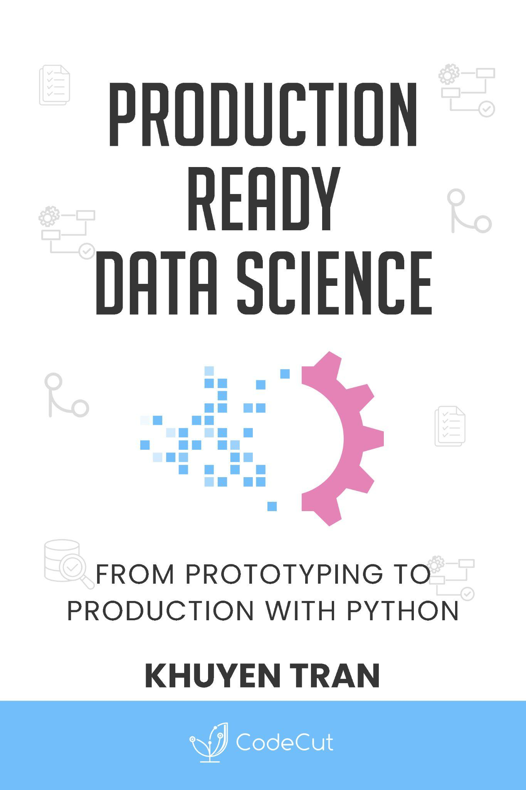
Khuyen Tran
Founder of CodeCut DevRel @ Nixtla
About Khuyen Tran
Founder of CodeCut (10,000+ Newsletter Readers)
110,000 LinkedIn Followers
Former MLOps Engineer at Accenture
Developer Advocate at Nixtla
Author of Production Ready Data Science
Notes:
Hi everyone, I'm Khuyen Tran. I'm the founder of CodeCut, where I publish a newsletter that reaches over 10,000 monthly readers with practical data science insights.
On LinkedIn, I've built a community of over 110k followers, the majority of whom are data scientists, data engineers, and data managers.
Previously, I worked as an MLOps Engineer and Senior Data Engineer at Accenture, where I implemented machine learning solutions for enterprise clients.
Currently, I serve as a Developer Advocate at Nixtla, working at the forefront of time series forecasting, which is exactly what we'll be exploring today.
I'm also the author of Production Ready Data Science, a book that covers best practices for taking data science projects from prototype to production. You can find the link to the book in the resources section of this presentation.

Slide 5
Agenda
01
Introduction to Zero-shot Forecasting
02
Zero-shot Forecasting with TimeGPT
03
Holiday Variables Forecast
04
Holiday SHAP Analysis
05
Special Dates Forecast
06
Special Dates SHAP Analysis
07
Summary
Notes:
This tutorial covers seven key areas of forecasting with TimeGPT.
First, we'll introduce zero-shot forecasting and explain why it solves business forecasting challenges.
Second, we'll demonstrate TimeGPT's zero-shot capabilities with real chocolate sales data.
Third, we'll forecast with holiday variables to capture recurring seasonal events.
Fourth, we'll analyze SHAP values to identify which holidays drive the strongest impacts.
Fifth, we'll create special dates forecasts for custom business-specific events.
Sixth, we'll analyze SHAP values to measure which custom events enhance predictions most.
Finally, we'll summarize key takeaways and practical benefits for your business.

Slide 6
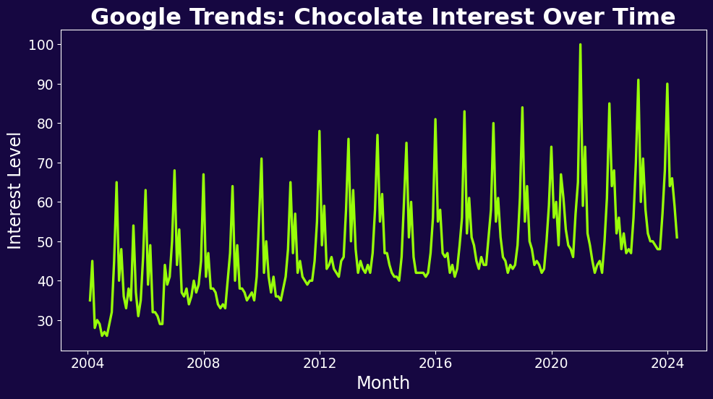
Introduction to Zero-shot Forecasting
The forecasting challenge
Scenario: You have historical chocolate sales data
Goal: Forecast future sales for planning
Challenge: You lack technical knowledge or time
>
Pg:2
Notes:
Imagine you're running a chocolate business and have historical data showing monthly chocolate interest.
Your goal is to forecast future chocolate sales to help with inventory planning, marketing budgets, and production scheduling.
What if you don't have the technical expertise or the time to learn complex forecasting techniques?
Traditional forecasting requires you to build, train, and validate models for each new dataset - a process that can take weeks and requires deep technical knowledge.
This creates significant barriers for most businesses.

Slide 7
Introduction to Zero-shot Forecasting
Zero-Shot Forecasting: The Solution
Accurate forecasts without model training
Leverages patterns from millions of time series
Removes time, complexity, and expertise barriers
>
Pg:2
Notes:
Zero-shot forecasting changes this completely. It means getting accurate forecasts immediately, without any model training or configuration.
The system has already learned from millions of time series patterns and can instantly apply that knowledge to your specific data.
This matters because it removes the biggest barriers to forecasting: time, complexity, and expertise requirements.

Slide 8
Introduction to Zero-shot Forecasting
Introducing TimeGPT
Nixtla is a platform for time-series forecasting
TimeGPT is their zero-shot forecasting foundation model
TimeGPT capabilities:
Built on transformer architecture
Trained on billions of time series
No model training required
Works immediately with your data
>
Pg:4
Notes:
Now that we reviewed zero-shot forecasting, let's meet the platform that makes it possible. Nixtla is a platform for time-series forecasting that offers both powerful open-source tools and foundation models.
TimeGPT is their zero-shot forecasting foundation model that solves the forecasting challenge we just discussed. It's built on transformer architecture and trained on billions of time series data points from diverse domains.
TimeGPT requires no model training and works immediately with your data by leveraging patterns it learned across different industries and use cases.
This enables TimeGPT to capture the patterns in any data automatically.
Now we will jump into the tutorial.
I will show you how TimeGPT performs out-of-the-box, then we will enhance its performance with dates features.

Slide 9
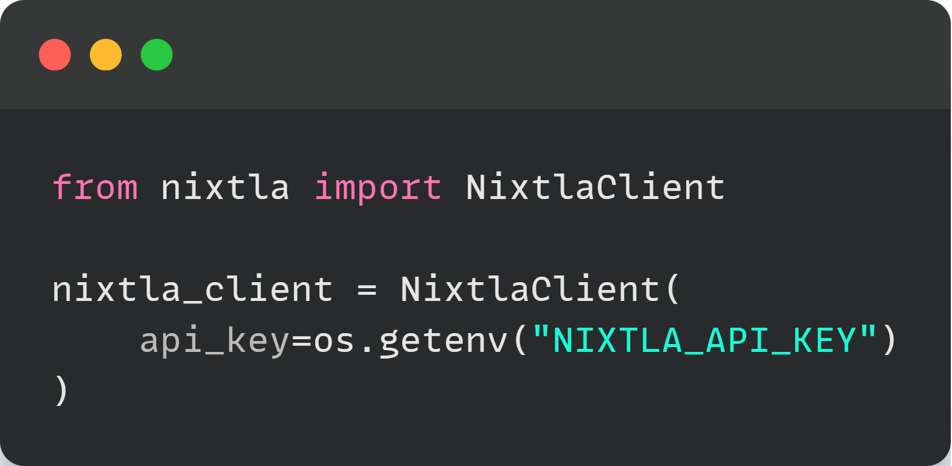
Zero-Shot Forecasting with TimeGPT
Initialize Nixtla Client
Start by initializing the Nixtla client
>
Pg:5
Notes:
To use TimeGPT, initialize the Nixtla client with your API key. You can obtain this API key by going to nixtla.io
Now we're ready to forecast.

Slide 10
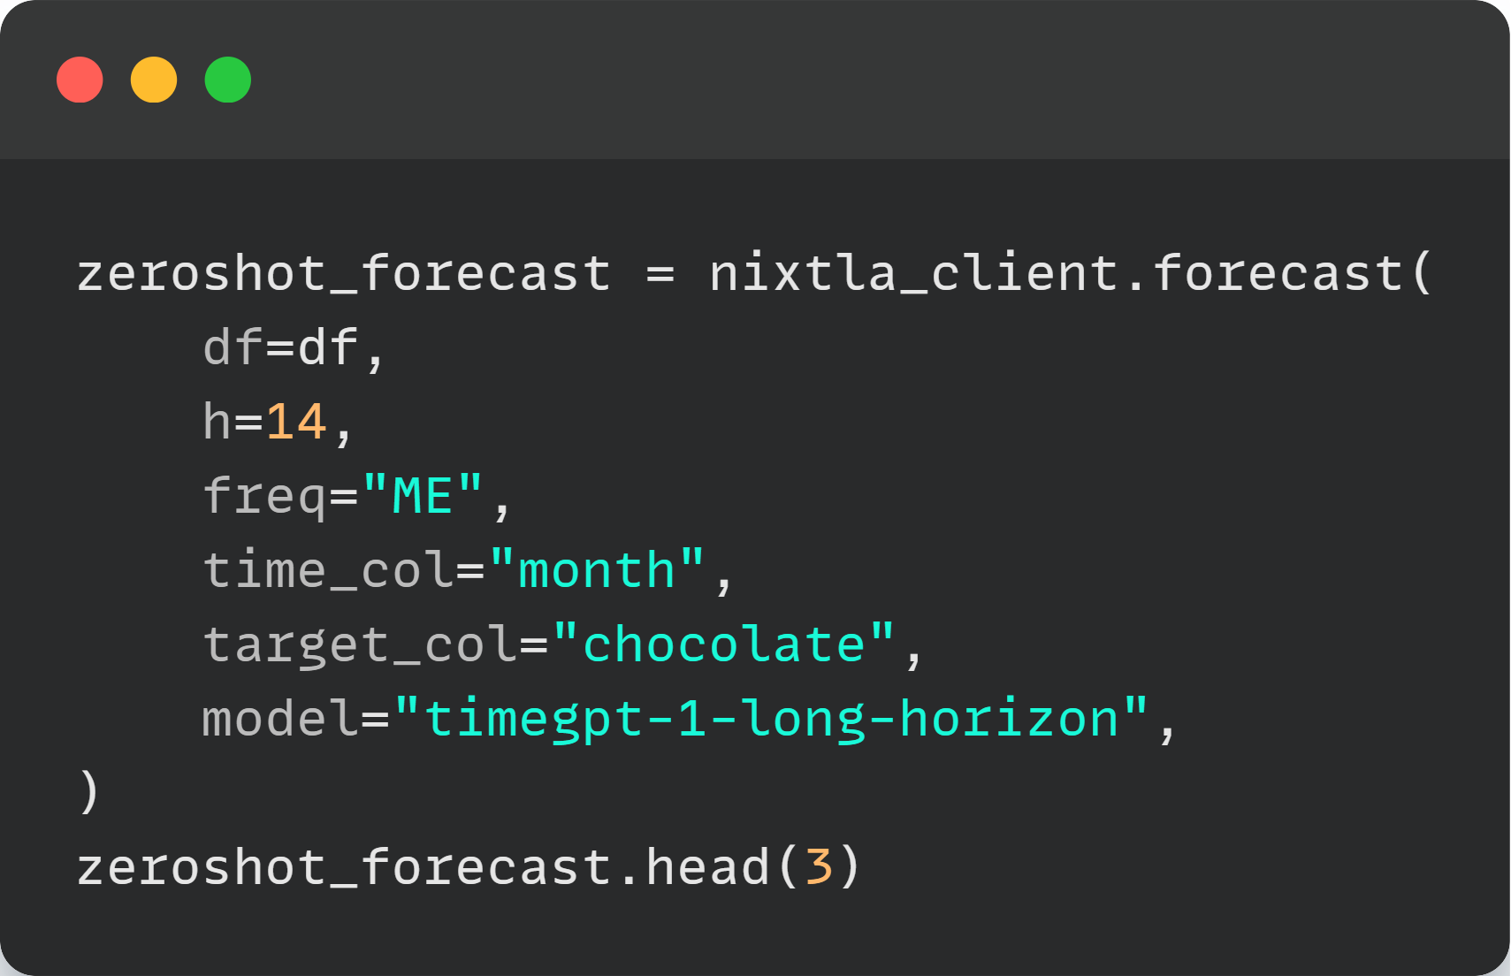
Zero-Shot Forecasting with TimeGPT
Zero-shot Forecasting with TimeGPT
Forecasting with TimeGPT is simple.
 | Month | TimeGPT
0 | 2004-01-31 | 48.61811
1 | 2004-02-29 | 50.40928
2 | 2004-03-31 | 49.3049
>
Pg: 6
Notes:
Forecasting with TimeGPT is simple. Using the Nixtla client we just initialized, call the forecast method with our chocolate sales data.
- `df` is our historical data
- `h=14` means we want to forecast 14 periods ahead
- `freq="ME"` specifies monthly end frequency
- the `time_col` and `target_col` specify the columns that contain the time index and target variable
- The model parameter uses the long-horizon version of TimeGPT which is optimized for longer forecasts.
That's it! TimeGPT generates the forecast without needing any model training or configuration. The forecast table shows future months with predicted chocolate sales values in the `TimeGPT` column.

Slide 11
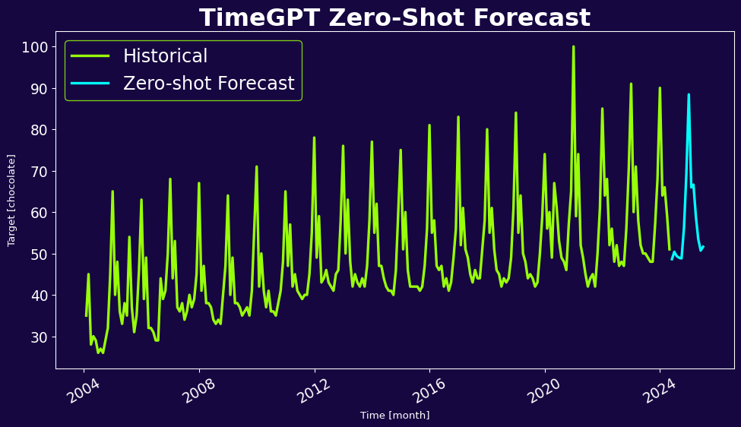
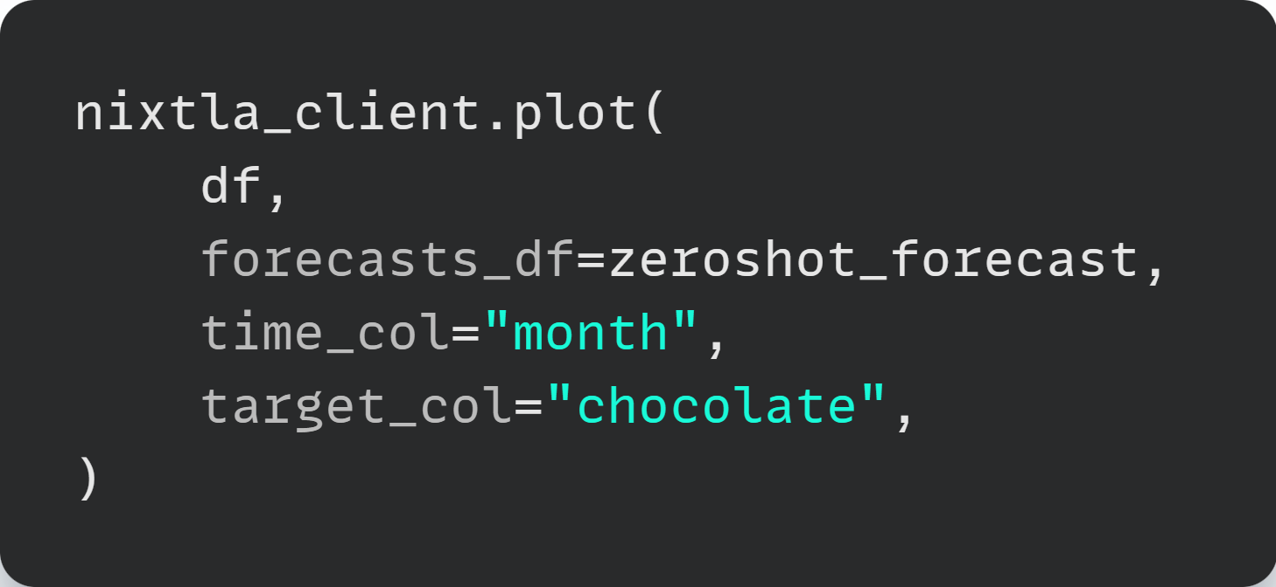
Zero-Shot Forecasting with TimeGPT
Visualize the forecast:
>
Pg:7
Notes:
Use the client's plot method to visualize the forecast. The forecast plot shows the historical data in green and the zero-shot forecast in blue.
Notice how TimeGPT's zero-shot forecast captures the general trend and seasonal patterns of the data without any training on that data.

Slide 12
Holiday Variables Forecast
Why Date Features?
You know that:
Chocolate sales are seasonal
Chocolate sales are influenced by holidays and special dates
>
Pg:4
Notes:
Building on TimeGPT's strong baseline performance, we can now enhance its predictions by incorporating business-specific knowledge about events that drive chocolate sales.
You know chocolate sales are seasonal with clear recurring patterns.
You also know they're influenced by specific holidays and special dates like Valentine's Day, Christmas, and Halloween.
Let's incorporate these date-based features into TimeGPT model.

Slide 13
Holiday Variables Forecast
What Are Date Features?
Date features are:
Holiday Variables: Recurring events (Christmas, New Year, etc.)
Special Dates: Custom dates specific to your business
Benefits:
Capture expected variations
Improve prediction accuracy
>
Pg:8
Notes:
Date features can be holidays or special dates.
Holiday Variables are recurring events like Christmas and New Year that happen every year on the same date.
Special Dates are custom dates specific to your business context. These are any events you define that might impact your data - could be promotions, product launches, or any other relevant dates.
These features capture expected variations and improve prediction accuracy.

Slide 14
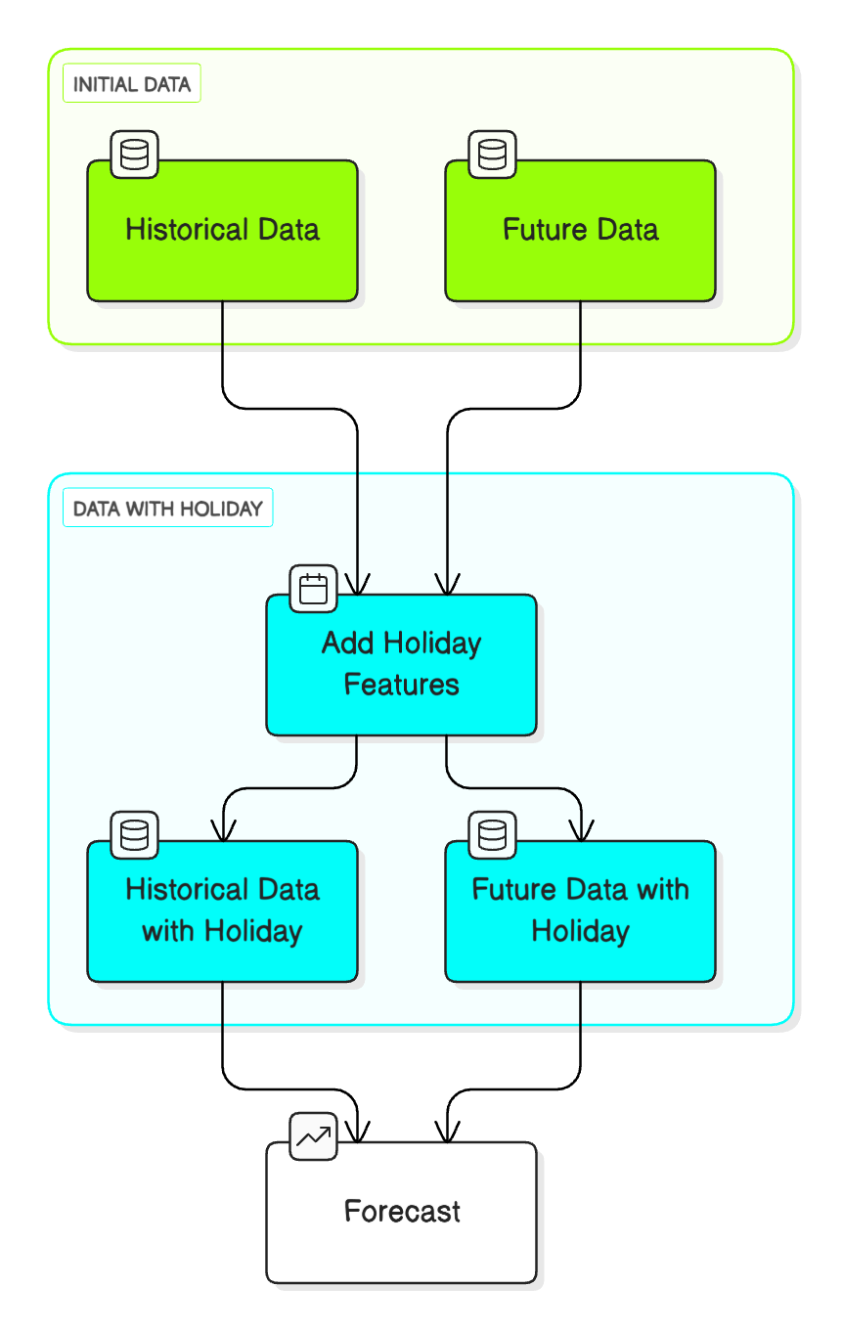
Holiday Variables Forecast
Adding Holiday Features
>
Notes:
Before diving into the details of how to add holiday features, let's understand the big picture of how we can do that.
First, create a future dataframe for your forecast period. A future dataframe contains future dates.
Second, add holiday features to both your historical training data and your future dataframe. This is crucial because both datasets need the exact same holiday columns.
Finally, generate enhanced forecasts using both historical and the future dataframe with holiday features. TimeGPT can now account for upcoming holidays in its predictions.

Slide 15
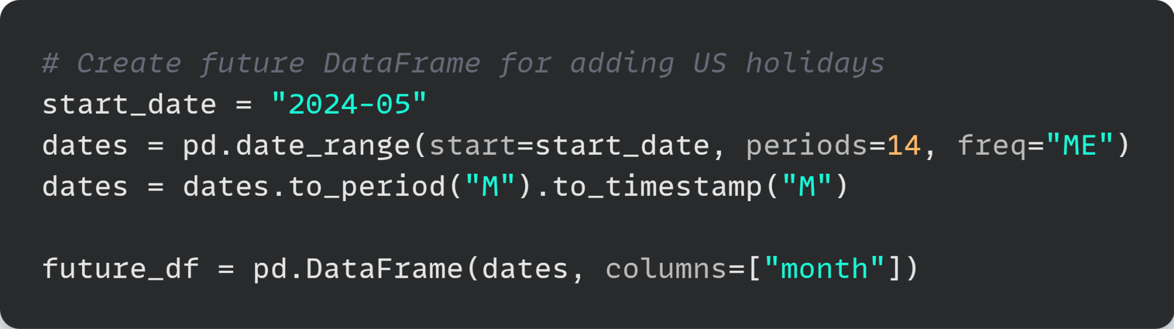
Holiday Variables Forecast
Create Future Dataframe
Month
2025-02-28 0:00:00
2025-03-31 0:00:00
2025-04-30 0:00:00
>
Pg:10
Notes:
Let's create a future dataframe for our forecast period.
The goal is to build a framework of future dates that matches our historical data structure. We generate 14 monthly dates extending from where our data ends, ensuring they align with our existing monthly format.
This creates a clean DataFrame with future dates ready for holiday features.
Now let's add holiday features to our future dataframe.

Slide 16
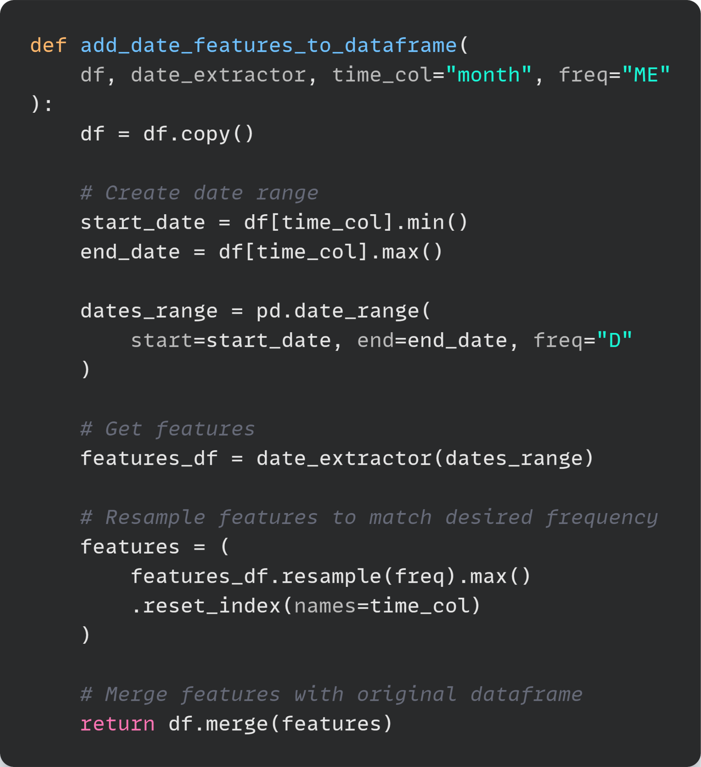
Holiday Variables Forecast
Add Holiday Features to Future DataFrame
Create a helper function to add date features to a dataframe.
>
Notes:
Before adding holiday features to our future dataframe, let's create a helper function to add date features to any dataframe.
The function works by expanding your dataframe's date range into daily intervals, adding holiday features across all those days, then condensing the results back to your original frequency while preserving holiday information.
This creates a reusable tool that can add holiday features to both historical and future data consistently.

Slide 17
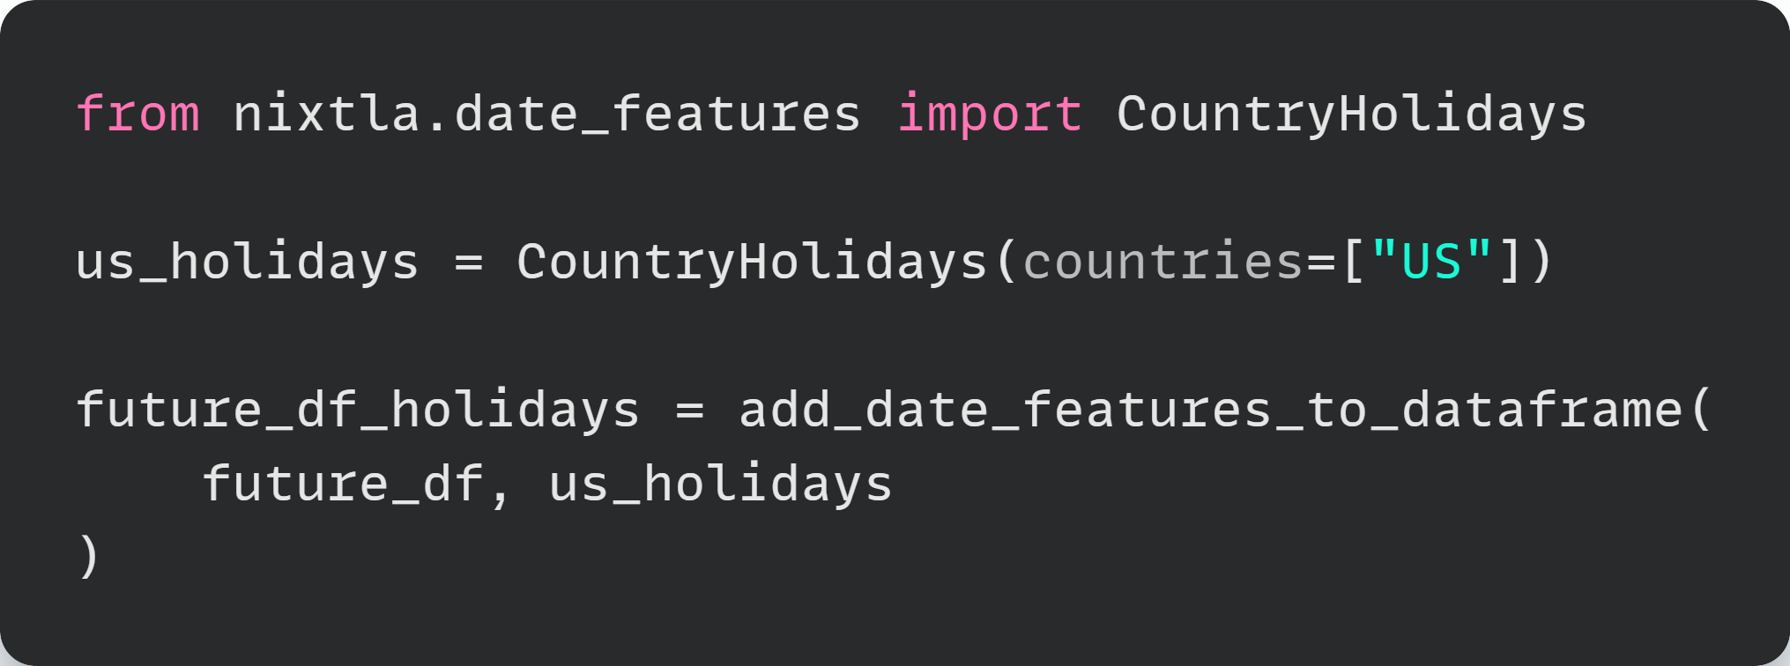
Holiday Variables Forecast
Use the helper function to add holiday features to the future dataframe
 | Month | New Years | Memorial | Juneteenth | Independence | Veterans | Thanksgiving | MLK | Washington
0 | 2024-05-31 | 0 | 0 | 0 | 0 | 0 | 0 | 0 | 0
1 | 2024-06-30 | 0 | 0 | 1 | 0 | 0 | 0 | 0 | 0
2 | 2024-07-31 | 0 | 0 | 0 | 1 | 0 | 0 | 0 | 0
>
Notes:
Now, let’s add holiday features to our future dataframe.
First, create a CountryHolidays object specifically for US holidays.
Then use our helper function to add these holiday features to the future dataframe.
This produces a future dataframe with holiday indicators that TimeGPT can use for forecasting.

Slide 18
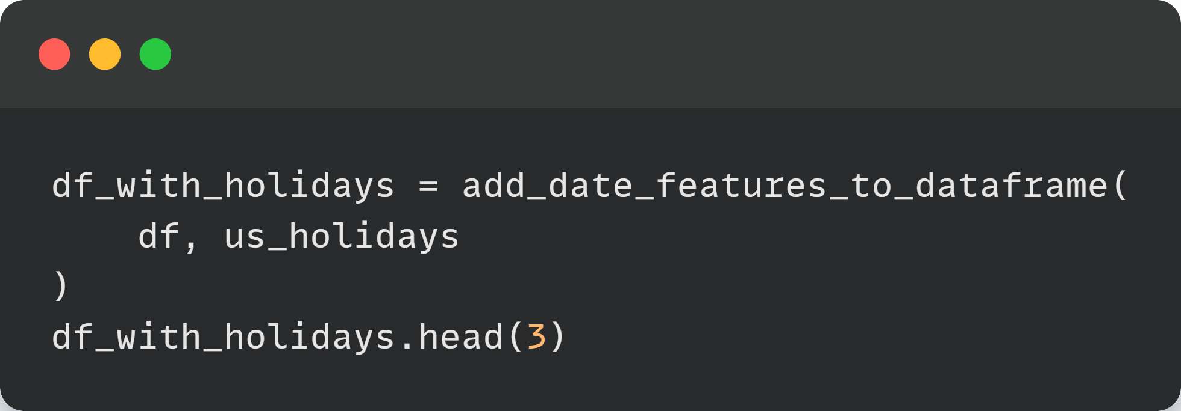
Holiday Variables Forecast
Add Holiday Features to Historical Dataframe
 | month | chocolate | New Year's | Thanksgiving | Washington | Christmas
0 | 2004-01-31 | 35 | 0 | 0 | 0 | 0
1 | 2004-02-29 | 45 | 0 | 0 | 1 | 0
2 | 2004-03-31 | 28 | 0 | 0 | 0 | 0
>
Notes:
Next, add holiday features to our historical data.
We can see that the historical dataframe now has holiday features similar to the future dataframe.

Slide 19
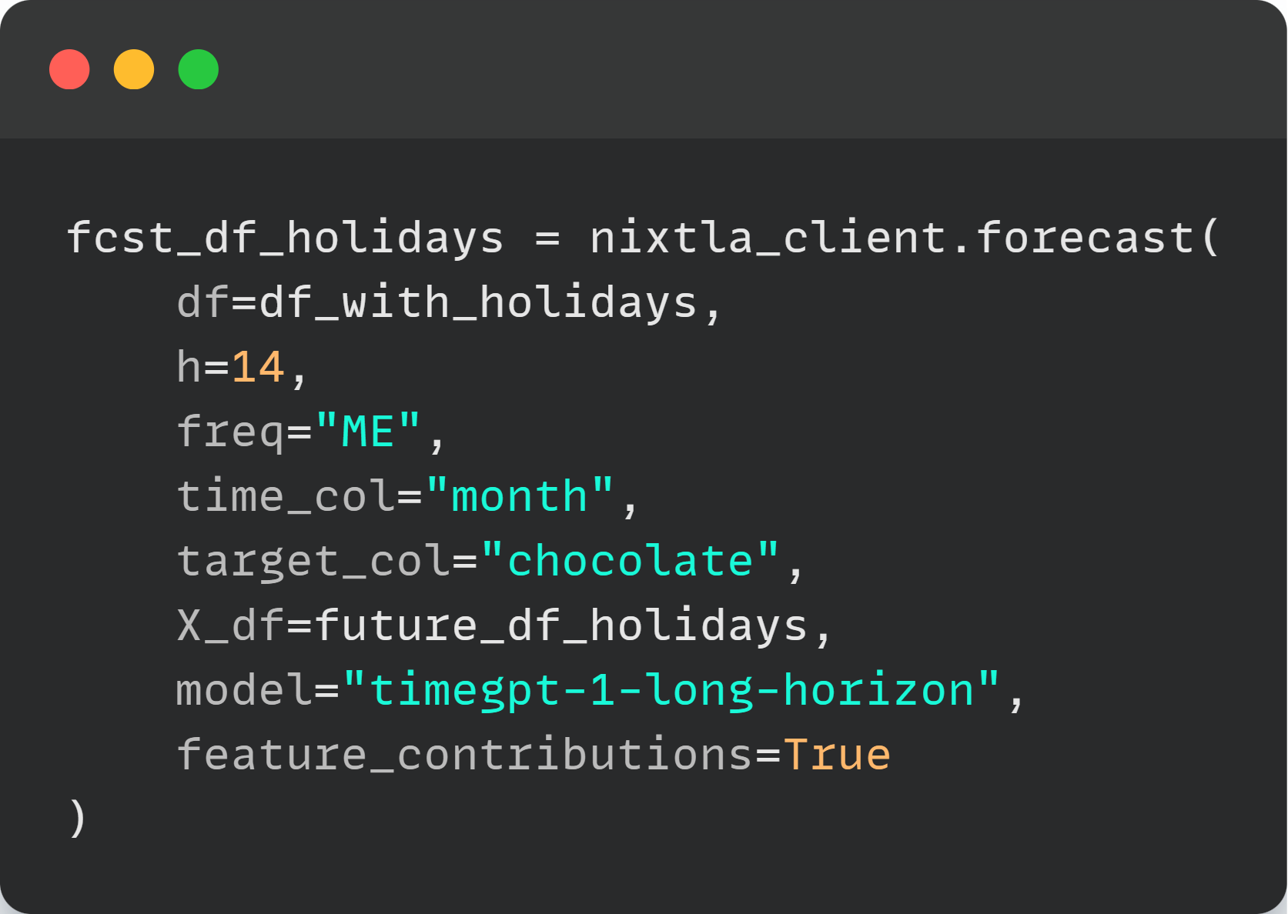
Holiday Variables Forecast
Forecast with Holiday Features
>
Pg: 14
Notes:
Now we can generate forecasts with holiday features included.
The process combines our holiday-enhanced historical data with future holiday information to create forecasts that account for seasonal events. We enable feature contributions to generate SHAP values, allowing us to analyze which holidays contribute most to forecast improvements.

Slide 20
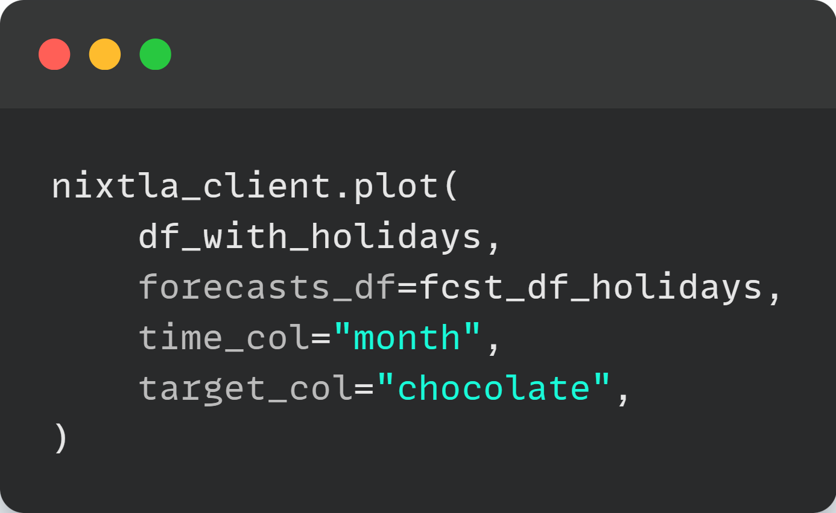
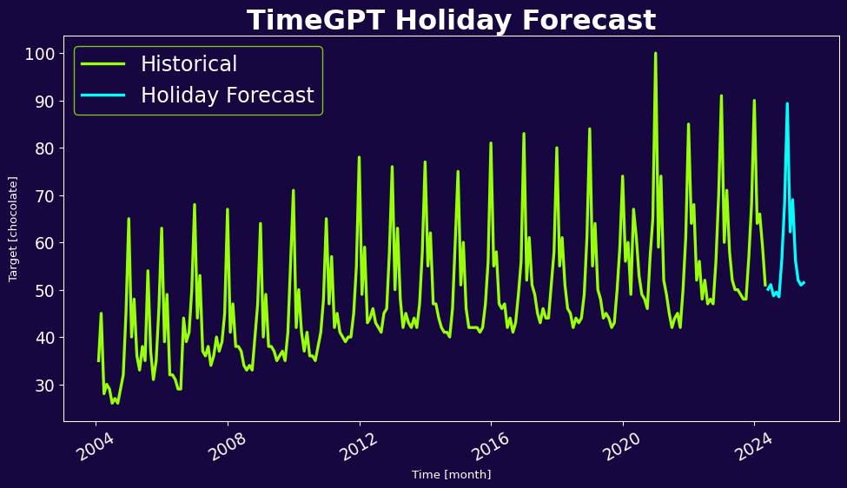
Holiday Variables Forecast
Holiday Forecast Plot
Visualize the forecast:
>
Pg: 15
Notes:
Next, visualize the holiday-enhanced forecast results using Nixtla's plotting function.

Slide 21
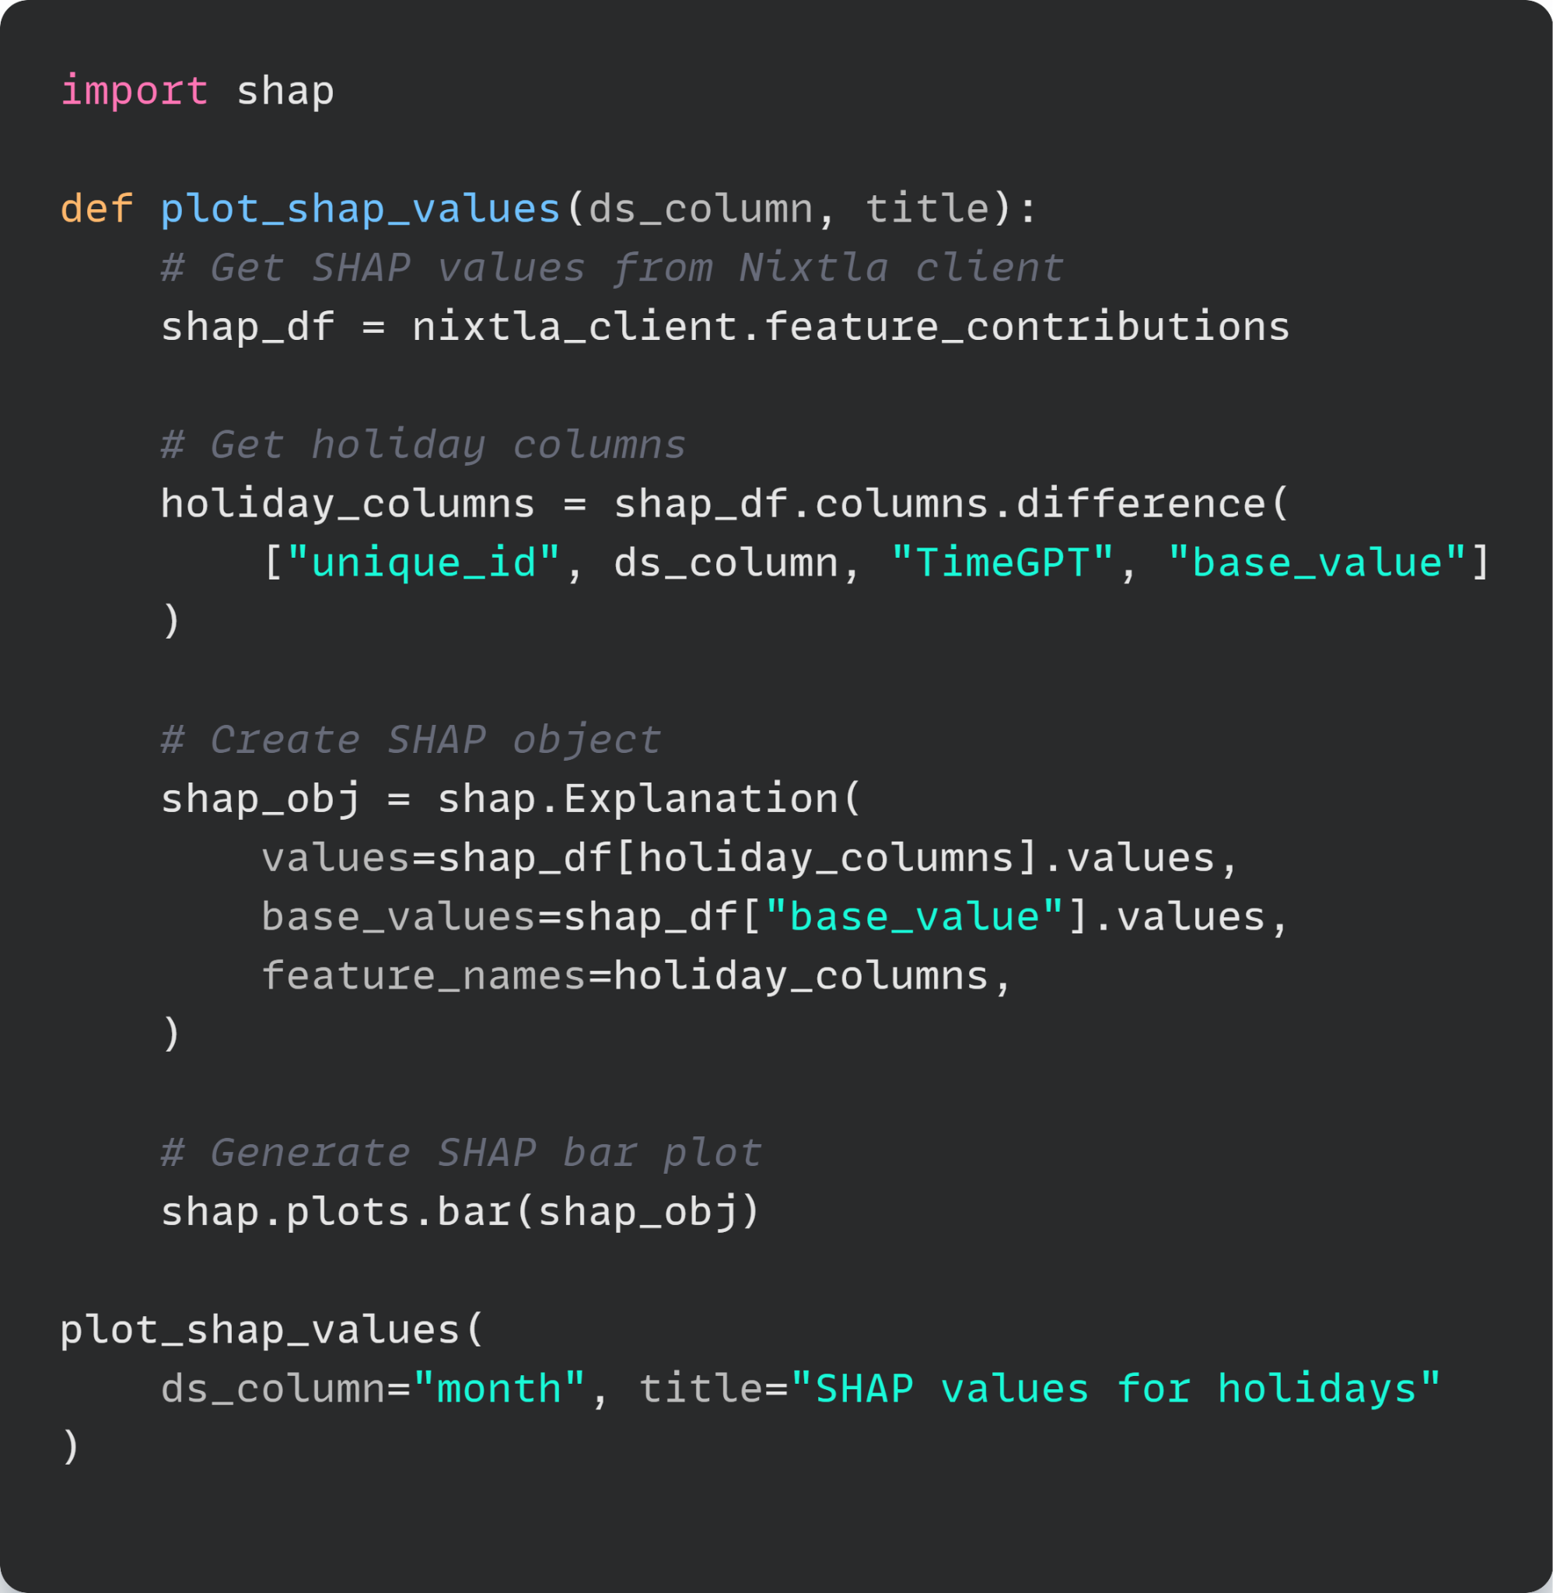
Holiday SHAP Analysis
Holiday SHAP Values
Use SHAP values to analyze the feature contributions of the holiday-enhanced model.
>
Pg: 16
Notes:
We will use SHAP values to analyze how holiday features enhance TimeGPT's zero-shot forecasting. First, create a function to plot SHAP values.
In this function, we get SHAP values from the Nixtla client.
Then, we filter to get only the holiday feature columns.
Create a SHAP Explanation object using the holiday feature values, baseline predictions, and holiday names to structure data for visualization.
Finally, call the function to create the SHAP analysis for our holiday enhancements.

Slide 22
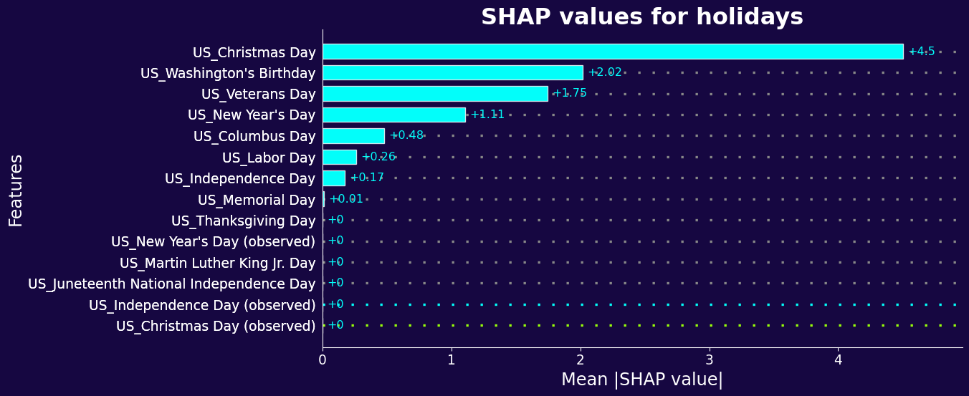
Holiday SHAP Analysis
SHAP Values
SHAP values reveal that Christmas, Independence Day, and Labor Day have the strongest influence on chocolate interest forecasting.
>
Pg: 17
Notes:
The bar plot shows the feature importance ranking for all holiday variables that enhance TimeGPT's forecasts.
Christmas Day has the highest SHAP value. This indicates it provides the strongest enhancement to chocolate interest predictions.
Other holidays like Washington's Birthday and Veterans Day also contribute positively to the forecasts.
These insights enable you to prioritize marketing efforts around the holidays that most influence chocolate sales.

Slide 23
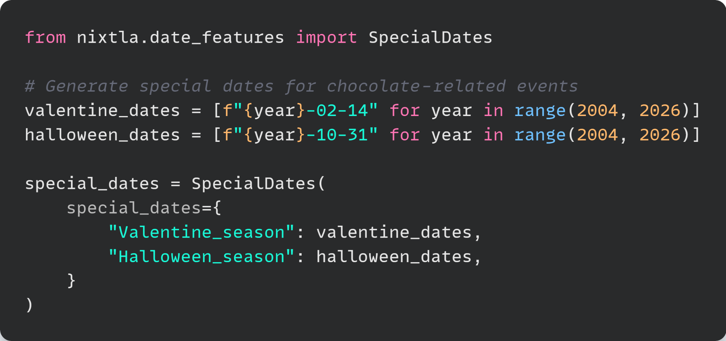
Holiday SHAP Analysis
Add Special Dates
Create special dates for Valentine’s Day and Halloween.
>
Pg: 18
Notes:
Special dates are custom dates specific to your business context.
In this example, we will create special dates for Valentine's Day and Halloween since they are both occasions when chocolate consumption typically increases.
First, generate date lists for Valentine's Day and Halloween covering years 2004 to 2025 to match our data range.
Next, create a SpecialDates object to organize these dates into a format that TimeGPT can process.

Slide 24
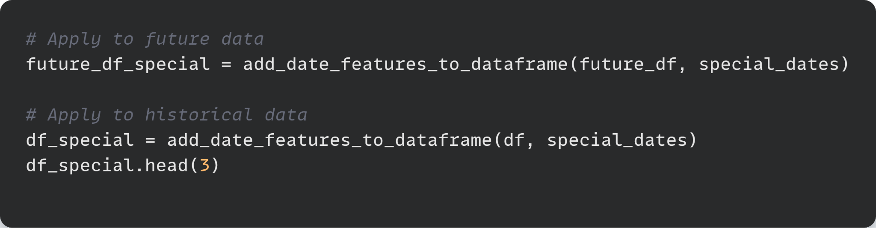
Special Dates Forecast
Add Special Dates to Future and Historical Data
Create special dates for Valentine’s Day and Halloween.
 | month | chocolate | Valentines_Season | Halloween_Season
0 | 2004-01-31 | 35 | 0 | 0
1 | 2004-02-29 | 45 | 1 | 0
2 | 2004-03-31 | 28 | 0 | 0
>
Pg: 19
Notes:
Similar to adding holiday features, we will also add special date features to both future and historical data.
We can see that each dataframe now has Valentine's Day and Halloween indicators for each month.

Slide 25
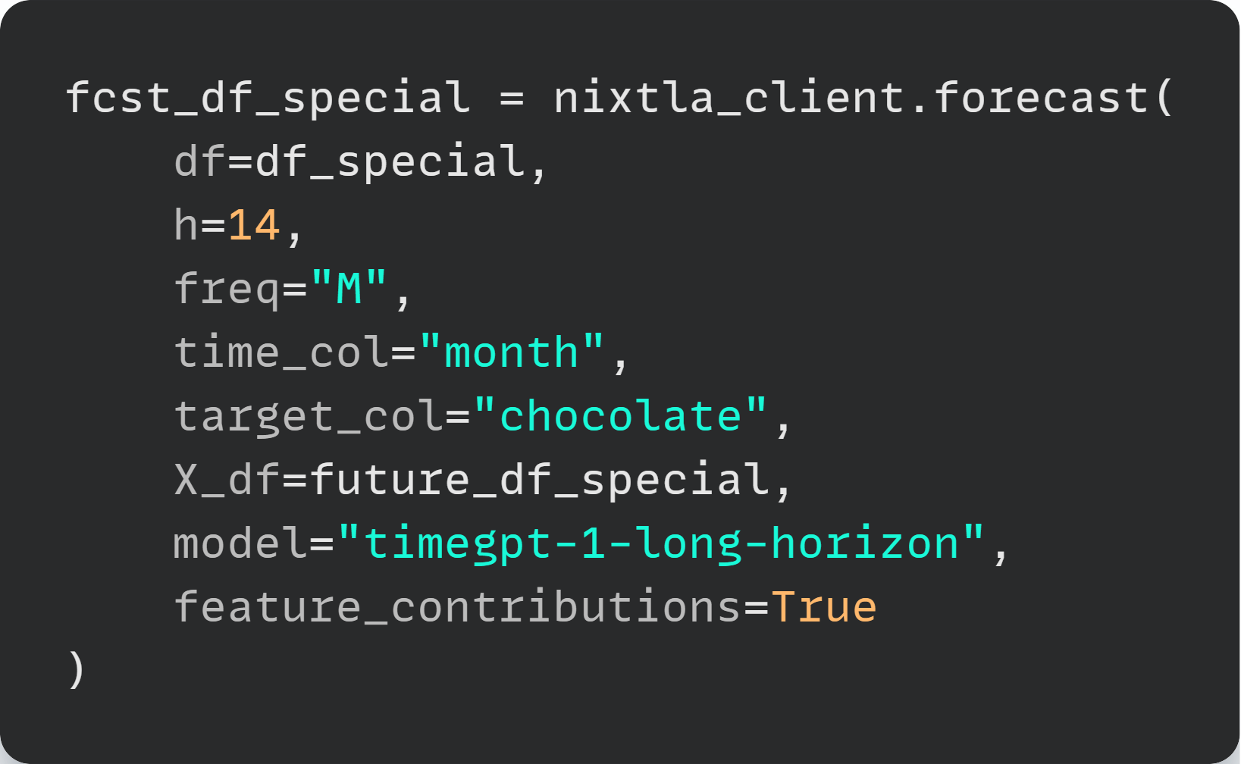
Special Dates Forecast
Forecast with Special Dates
>
Pg: 20
Notes:
Next, generate forecasts with special date features

Slide 26
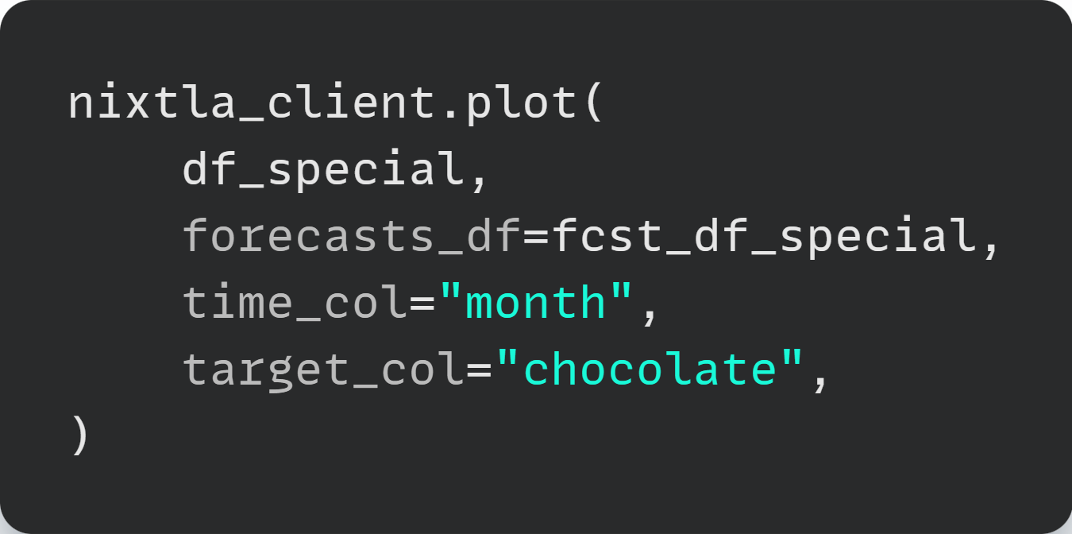
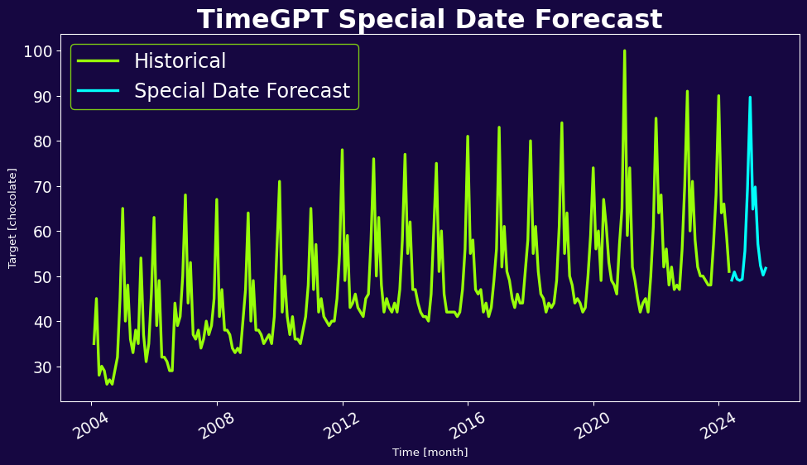
Special Dates Forecast
Plot Special Date Forecast
>
Pg: 21
Notes:
Finally, visualize the special date-enhanced forecast using Nixtla's plotting function.

Slide 27
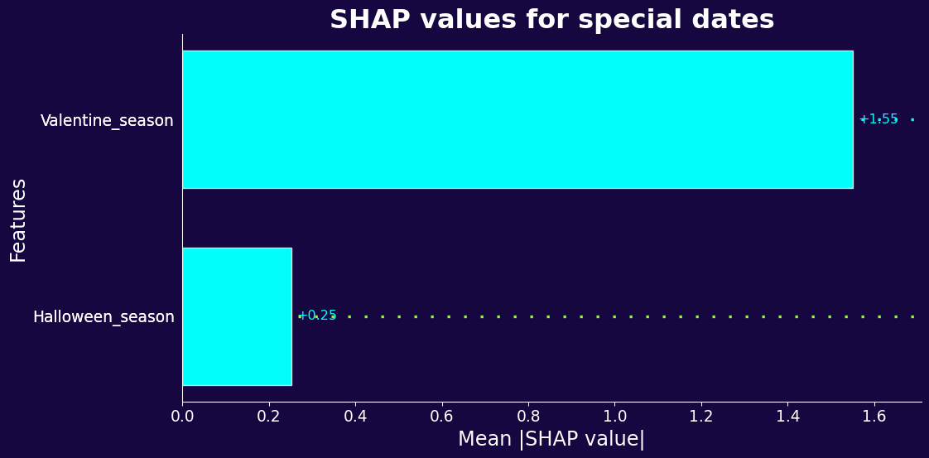
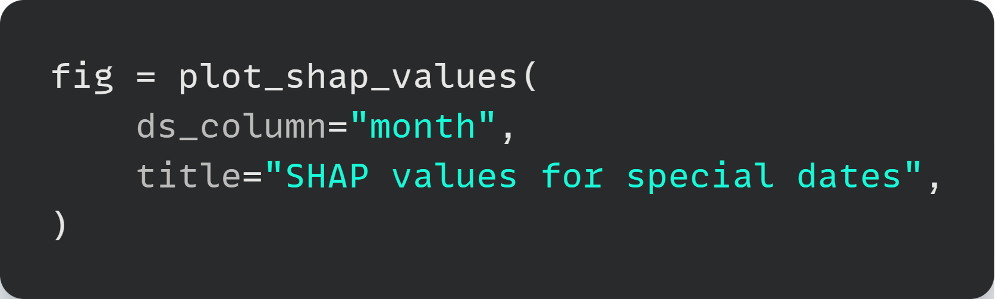
Special Dates SHAP Analysis
Special date SHAP values
Valentine’s Day has the strongest positive impact on chocolate sales forecasts!
>
Pg: 22
Notes:
Now let's analyze how special date features contribute to TimeGPT's forecasts.
The plot shows that Valentine's Day has the strongest positive impact on enhancing chocolate interest predictions. This makes perfect sense as Valentine's Day is the most popular day for chocolate gifts.
Halloween shows a much smaller contribution. This reflects that while Halloween involves candy consumption, chocolate specifically may not be as dominant during Halloween compared to Valentine's Day.
The dramatic difference between these two special dates provides business owners the information needed to optimize their marketing strategies and inventory management.

Slide 28
Summary
Summary
In this tutorial, you have learned how to:
Forecast with TimeGPT
Add holiday features to both historical and future data
Add special date features to both historical and future data
Analyze feature importance using SHAP values
Benefits of adding date features to TimeGPT:
Zero-shot forecasting without technical expertise
Capture seasonal patterns and event-driven variations
Identify which events most impact your forecasts
>
Pg: 23
Notes:
In this tutorial, you have learned how to:
1. Forecast with TimeGPT
2. Add holiday features to both historical and future data
3. Add special date features to both historical and future data
4. Analyze feature importance using SHAP values
With TimeGPT forecasting, you get zero-shot forecasting without technical expertise and capture seasonal patterns and event-driven variations. You can identify which events most impact your forecasts and use this information to optimize your business strategies.

Slide 29
Thank You

